Slide 1

Chapter 19
Domain Name
System
(DNS)
Copyright © The McGraw-Hill Companies, Inc. Permission required for reproduction or display.

Slide 2
OBJECTIVES:
To describe the purpose of DNS.
To define the concept of domains and domain name space.
To describe the distribution of name spaces and define zones.
To discuss the use of DNS in the Internet and describe three categories of domains: generic, country, and reverse.
To discuss name-address resolution and show the two resolution methods: recursive and iterative.
To show the format of DNS message and how they can be compressed.
To discuss DDNS and DNSSEC..

Slide 3
Chapter
Outline
19.1 Need for DNS
19.2 Name Spaces
19.3 DNS in the Internet
19.4 Resolution
19. 5 DNS Messages
19. 6 Types of Records
19. 7 Compression
19. 8 Encapsulation
19. 9 Registrars
19. 10 DDNS
19. 11 Security of DNS

Slide 4
19-1 NEED FOR DNS
To identify an entity, TCP/IP protocols use the IP address, which uniquely identifies the connection of a host to the Internet. However, people prefer to use names instead of numeric addresses. Therefore, we need a system that can map a name to an address or an address to a name.

Slide 5
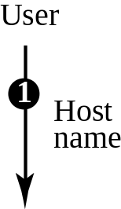
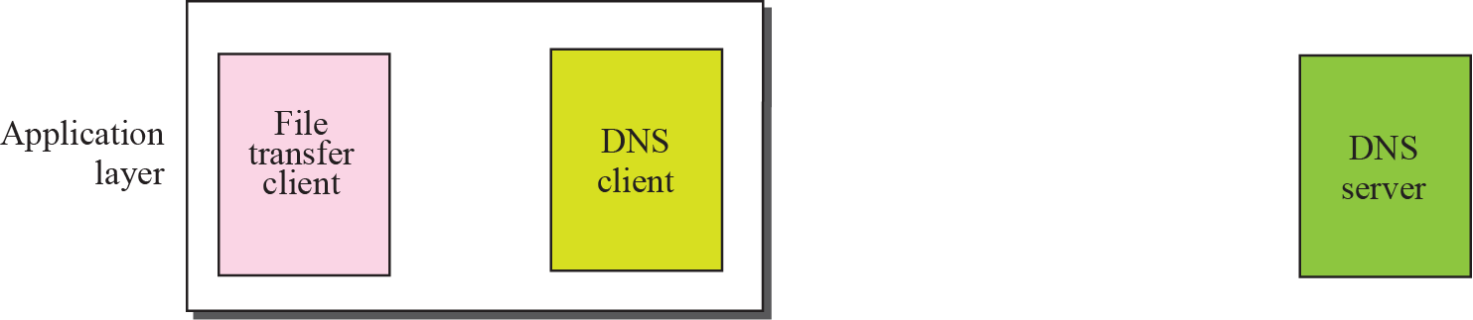
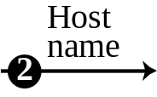
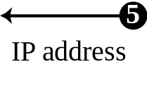
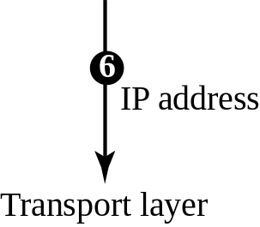
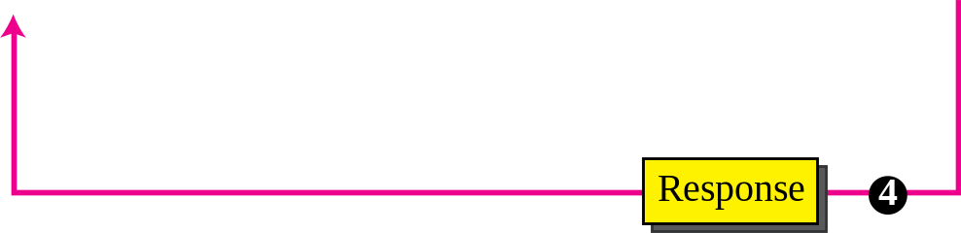
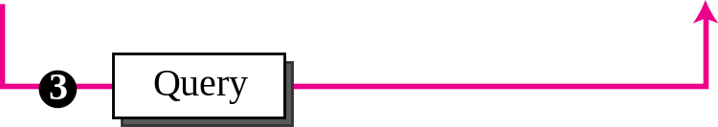
Figure 19.1 Purpose of DNS

Slide 6
19-2 NAME SPACE
To be unambiguous, the names assigned to machines must be carefully selected from a name space with complete control over the binding between the names and IP addresses. In other words, the names must be unique because the addresses are unique. A name space that maps each address to a unique name can be organized in two ways: flat or hierarchical.

Slide 7
Topics Discussed in the Section
Flat Name Space
Hierarchical Name Space
Domain Name Space
Domain
Distribution of Name Space

Slide 8
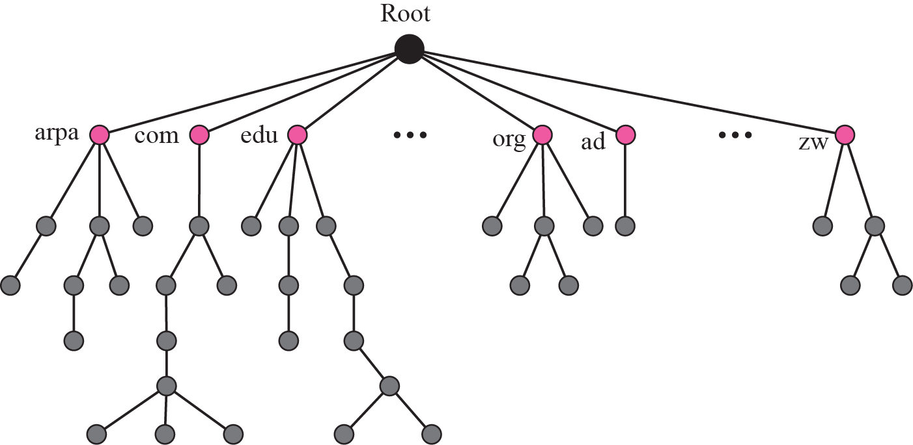
Figure 19.2 Domain name space

Slide 9
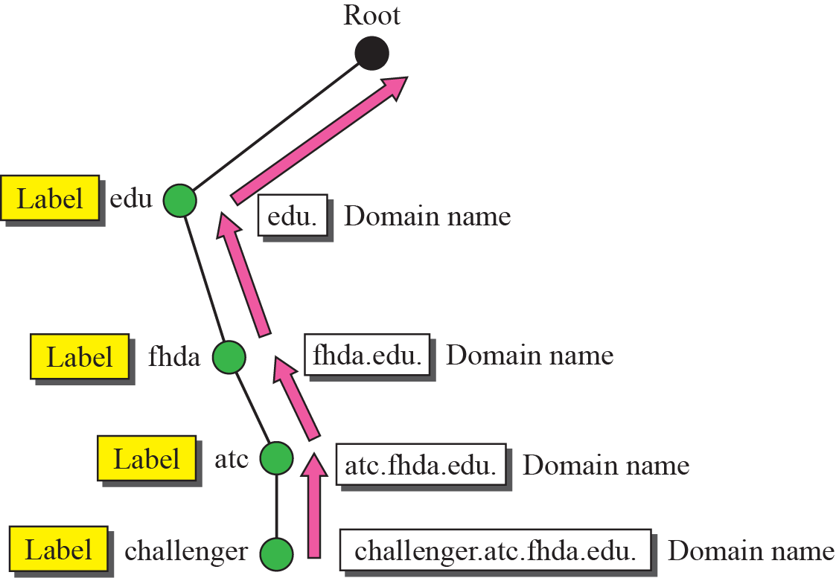
Figure 19.3 Domain names and labels

Slide 10

Figure 19.4 FQDN and PQDN

Slide 11
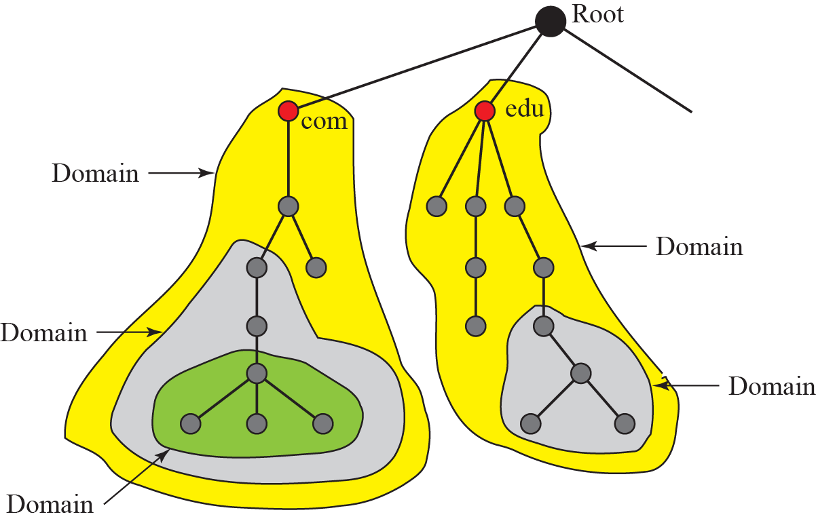
Figure 19.5 Domains

Slide 12
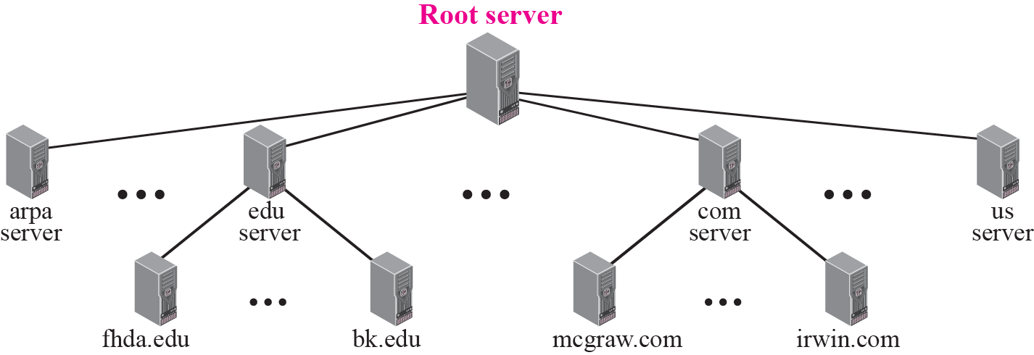
Figure 19.6 Hierarchy of name servers

Slide 13
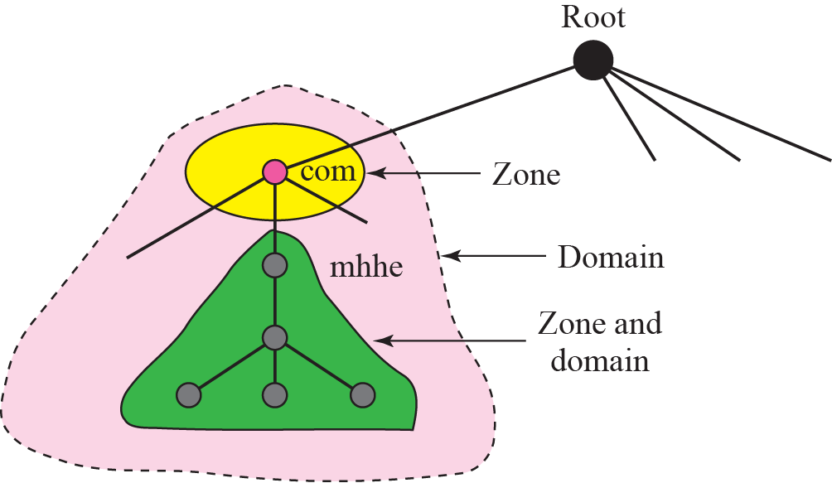
Figure 19.7 Zones and domains

Slide 14

Note
A primary server loads all information from the disk file; the secondary server loads all information from the primary server.
When the secondary downloads information from the primary, it is
called zone transfer.

Slide 15
19-3 DNS IN THE INTERNET
DNS is a protocol that can be used in different platforms. In the Internet, the domain name space (tree) is divided into three different sections: generic domains, country domains, and the inverse domain (see Figure 19.8).

Slide 16
Topics Discussed in the Section
Generic Domains
Country Domains
Inverse Domain
Registrar

Slide 17
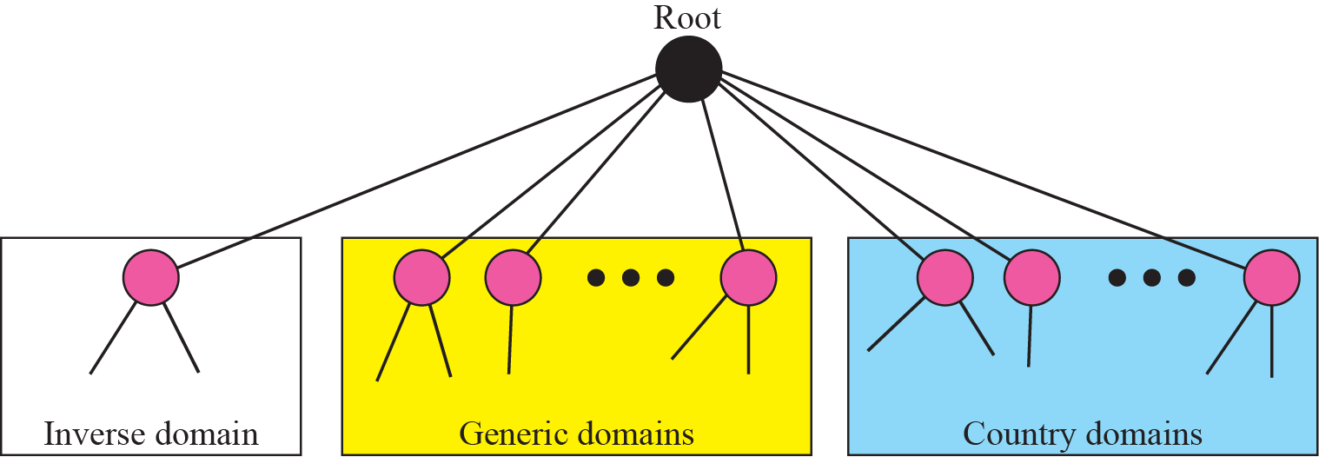
Figure 19.8 DNS used in the Internet

Slide 18
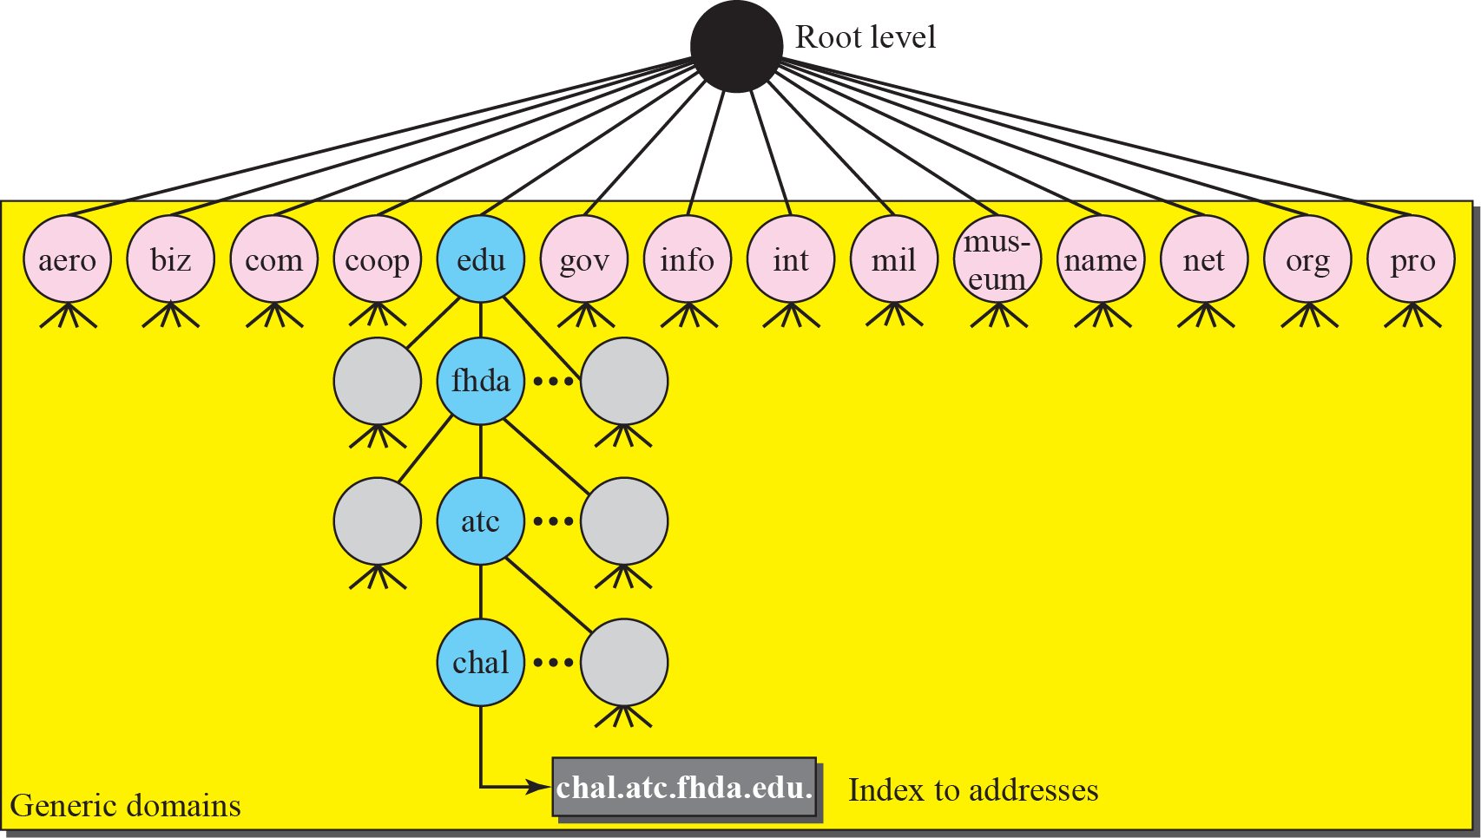
Figure 19.9 Generic domains

Slide 19
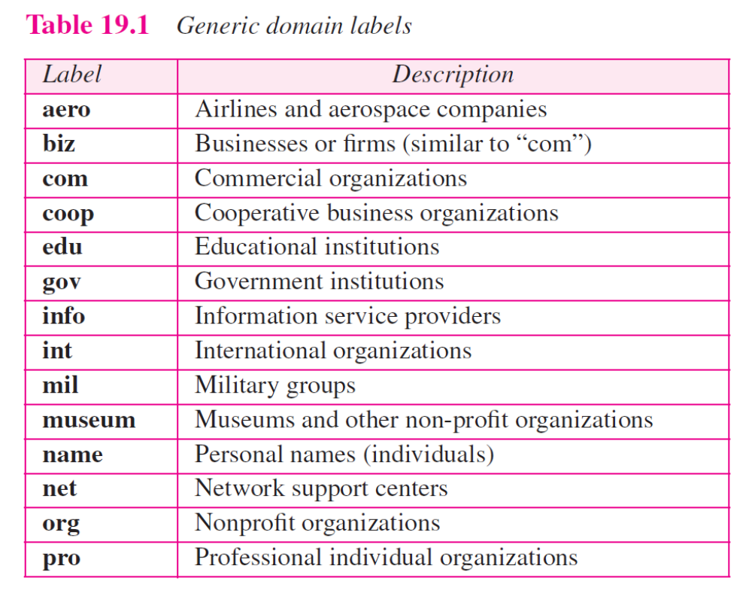

Slide 20
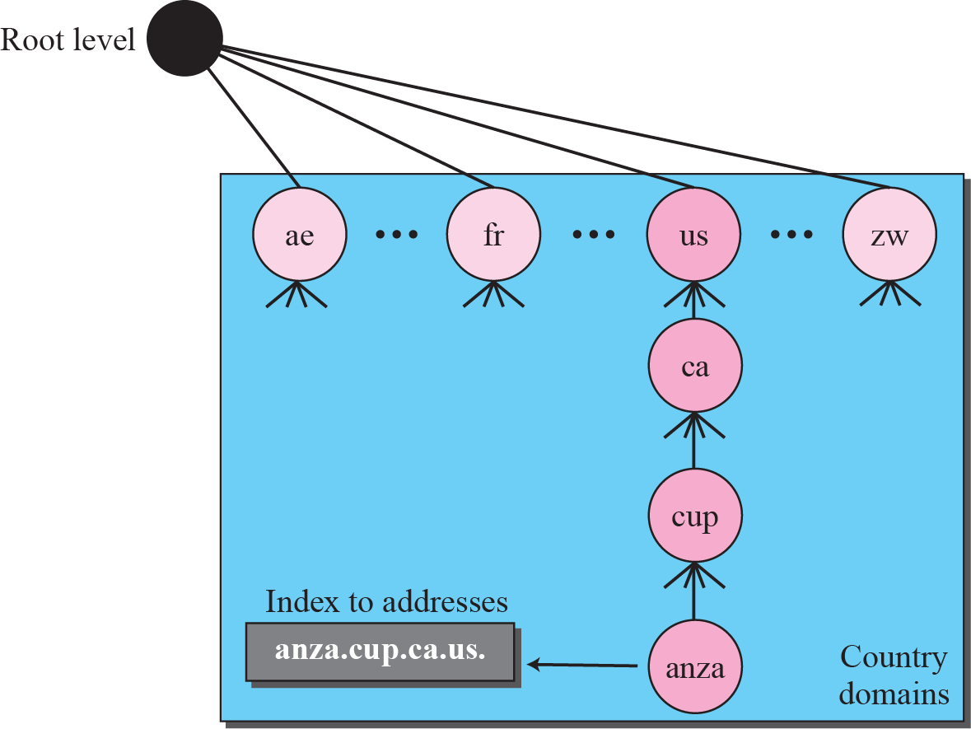
Figure 19.10 Country domains

Slide 21
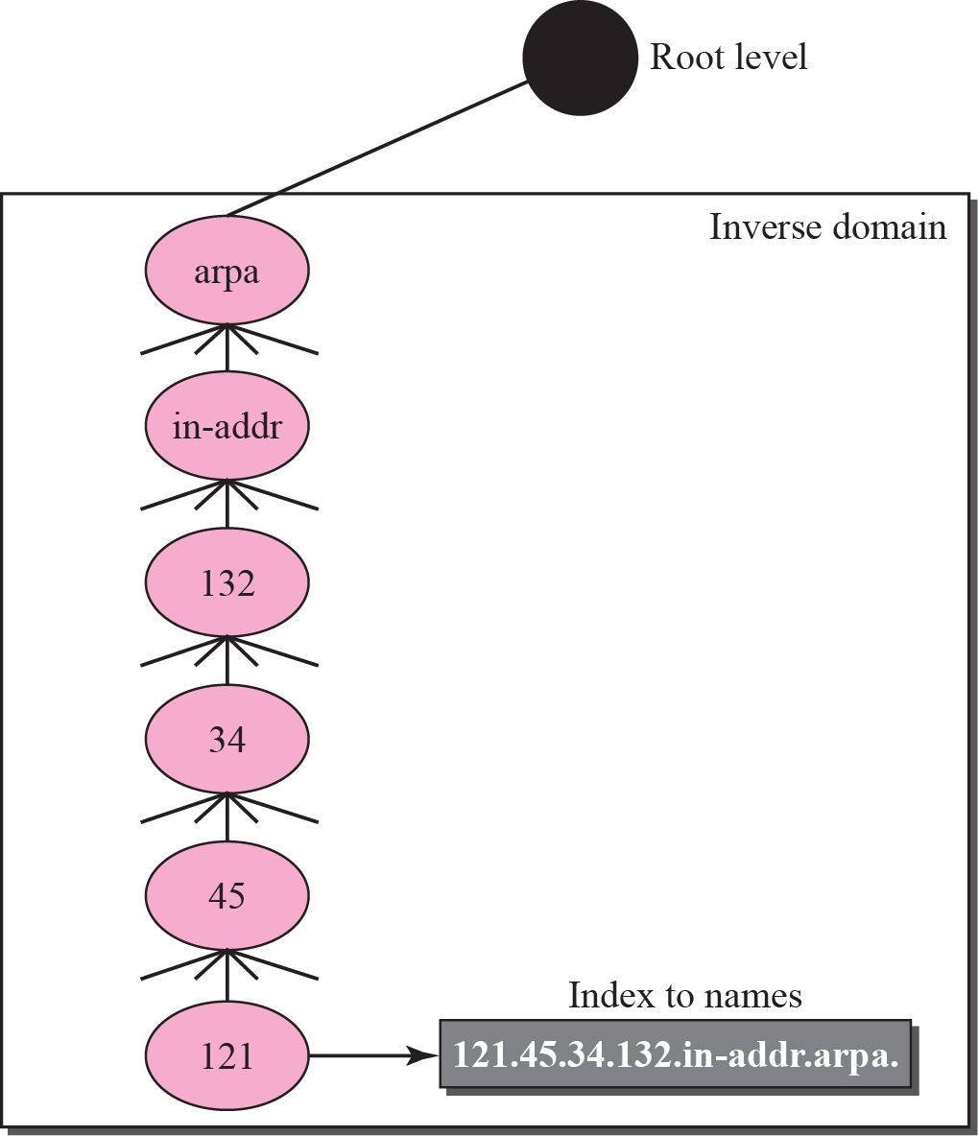
Figure 19.11 Inverse domain

Slide 22
19-4 RESOLUTION
Mapping a name to an address or an address to a name is called name-address resolution.

Slide 23
Topics Discussed in the Section
Resolver
Mapping Names to Addresses
Mapping Addresses to Names
Recursive Resolution
Iterative Resolution
Caching

Slide 24
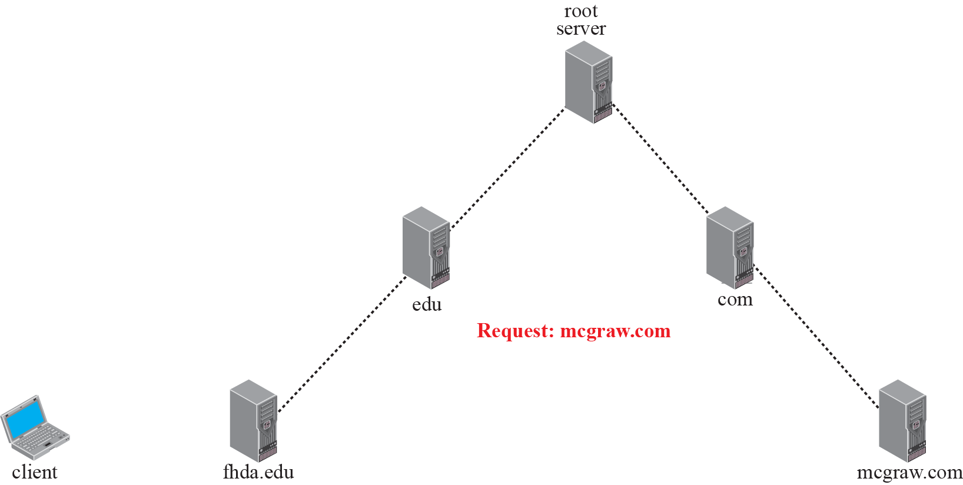










Figure 19.12 Recursive resolution

Slide 25
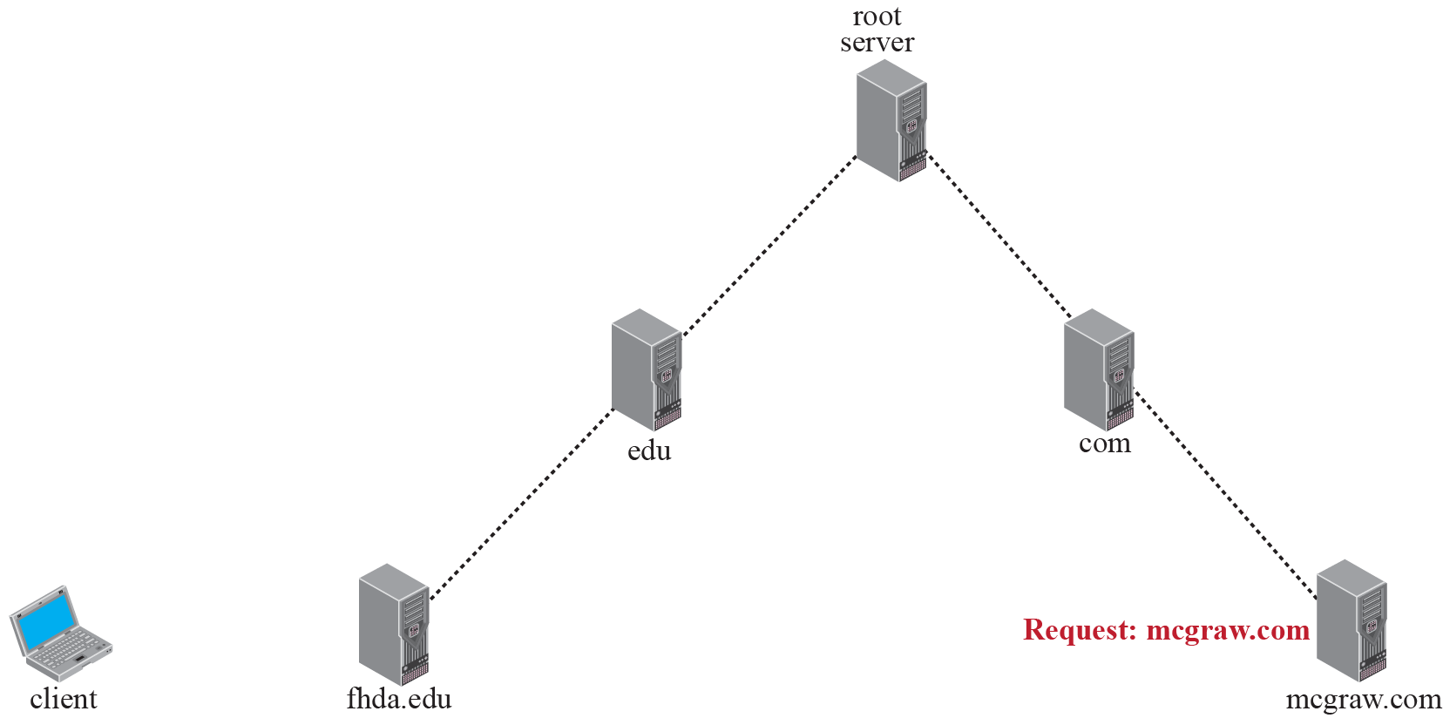










Figure 19.13 Iterative resolution

Slide 26
19-5 DNS MESSAGES
DNS has two types of messages: query and response. Both types have the same format. The query message consists of a header and question records; the response message consists of a header, question records, answer records, authoritative records, and additional records (see Figure 19.14).

Slide 27
Topics Discussed in the Section
Header

Slide 28

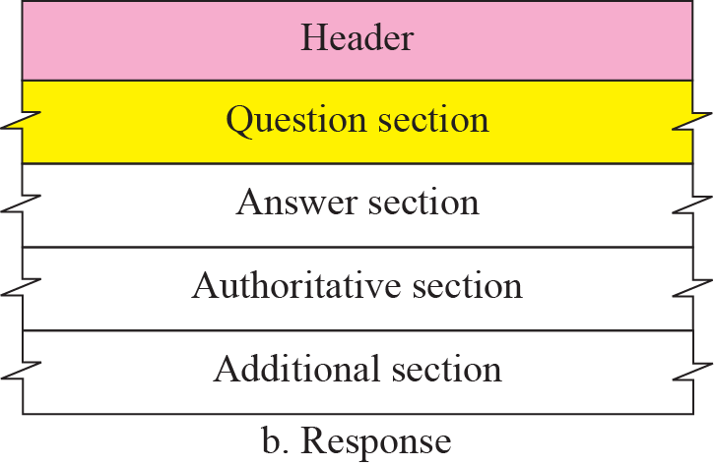
Figure 19.14 Query and response messages

Slide 29
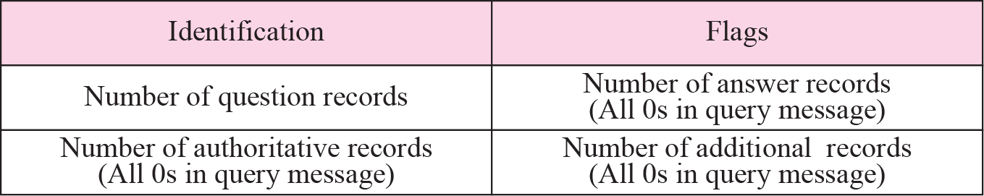
Figure 19.15 Header format

Slide 30
Figure 19.16 Flags field

Slide 31
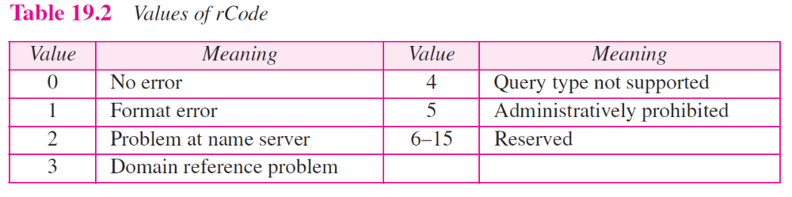

Slide 32
19-6 TYPES OF RECORDS
As we saw in the previous section, two types of records are used in DNS. The question records are used in the question section of the query and response messages. The resource records are used in the answer, authoritative, and additional information sections of the response message.

Slide 33
Topics Discussed in the Section
Question Record
Resource Record

Slide 34

Figure 19.17 Question record format

Slide 35
Figure 19.18 Query name format

Slide 36
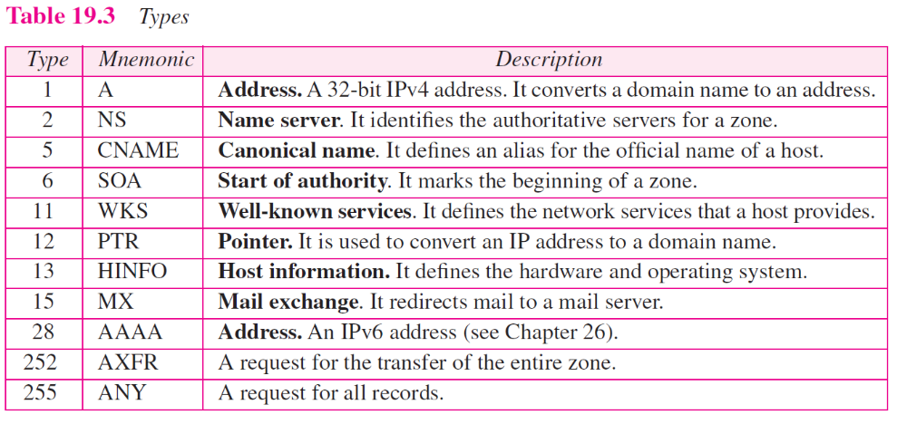

Slide 37
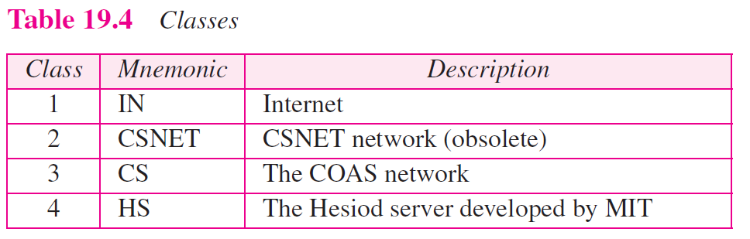

Slide 38
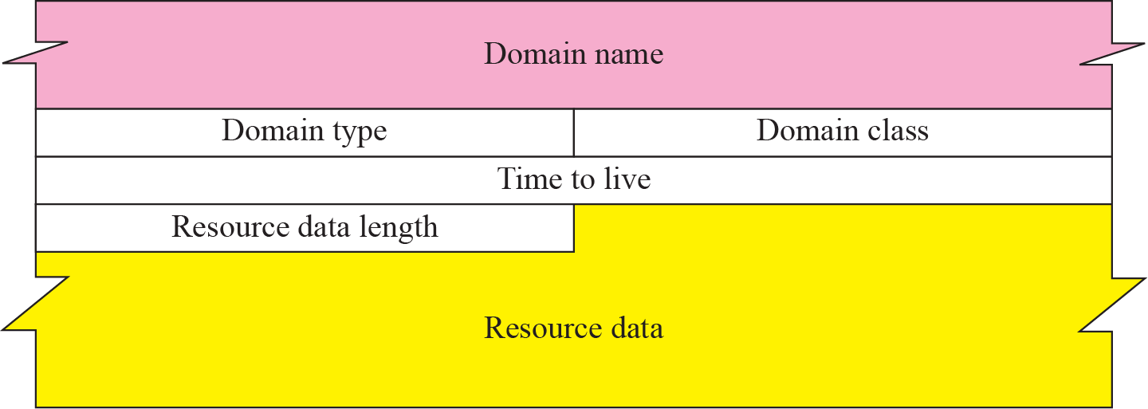
Figure 19.19 Resource record format

Slide 39
19-7 COMPRESSION
DNS requires that a domain name be replaced by an offset pointer if it is repeated. For example, in a resource record the domain name is usually a repetition of the domain name in the question record. For efficiency, DNS defines a 2-byte offset pointer that points to a previous occurrence of the domain or part of it. The format of the field is shown in Figure 19.20.

Slide 40
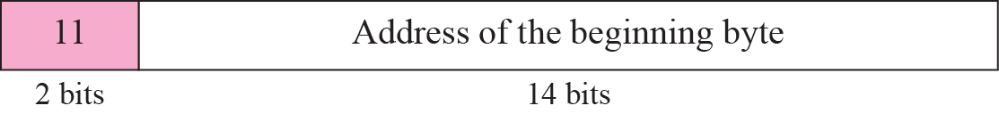
Figure 19.20 Format of an offset pointer

Slide 41
Example 19.1
A resolver sends a query message to a local server to find the IP address for the host “chal.fhda.edu.”. We discuss the query and response messages separately. Figure 19.21 shows the query message sent by the resolver. The first 2 bytes show the identifier (1333)₁₆. It is used as a sequence number and relates a response to a query. The next bytes contain the flags with the
value of 0x0100 in hexadecimal. In binary it is 0000000100000000, but it is more meaningful to divide it into the fields as shown below:

Slide 42
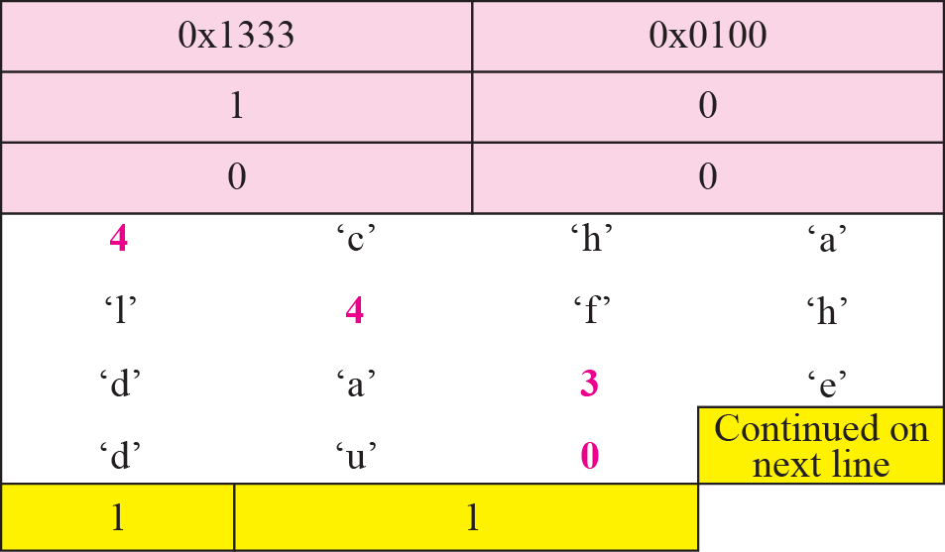
Figure 19.21 Example 19.1: Query message

Slide 43
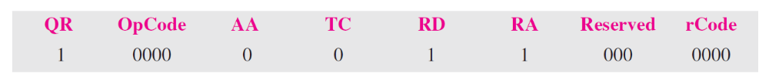
Example 19.1 Continued
Figure 19.22 shows the response of the server. The response is similar to the query except that the flags are different and the number of answer records is one. The flags value is 0x8180 in hexadecimal. In binary it is 1000000110000000, but again we divide it into fields as shown below:

Slide 44
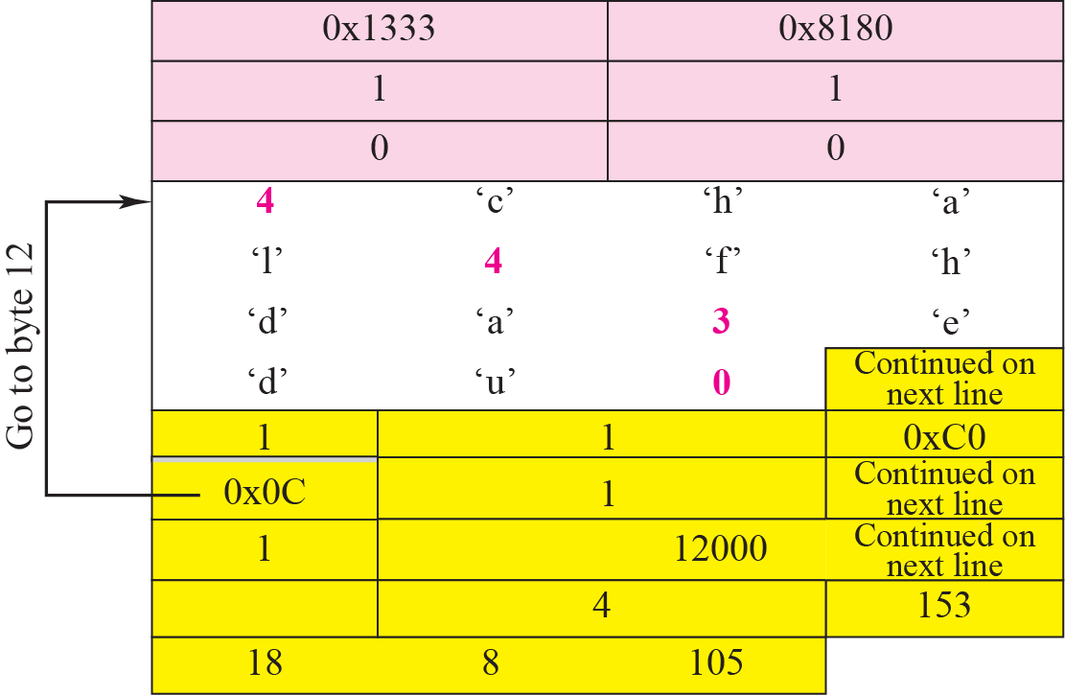
Figure 19.22 Example 19.1: Response message

Slide 45
Example 19.2
An FTP server has received a packet from an FTP client with IP address 153.2.7.9. The FTP server wants to verify that the FTP client is an authorized client. The FTP server can consult a file containing the list of authorized clients. However, the file consists only of domain names. The FTP server has only the IP address of the requesting client, which was the source IP address in the received IP datagram. The FTP server asks the resolver (DNS client) to send an inverse query to a DNS server to ask for the name of the FTP client. We discuss the query and response messages separately. Figure 19.23 shows the query message sent from the resolver to the server.

Slide 46
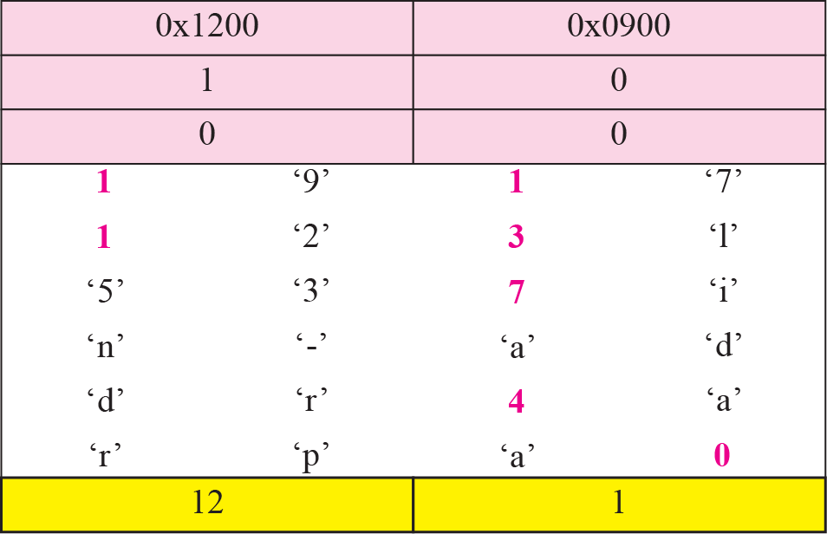
Figure 19.23 Example 19.2: Inverse query message

Slide 47
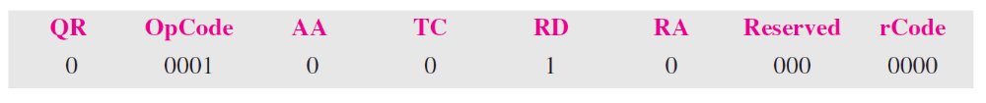
Example 19.2 Continued
The first 2 bytes show the identifier (0x1200). The flags value is 0x0900 in hexadecimal. In binary it is 0000100100000000, and we divide it into fields as shown below:
The OpCode is 0001, which defines an inverse query. The message contains only one question record. The domain name is 19171231537in-addr4arpa. The next 2 bytes define the query type as PTR, and the last 2 bytes define the class as the Internet. Figure 19.24 shows the response. The flags value is 0x8D80 in hexadecimal. In binary it is 1000110110000000, and we divide it into fields as shown below:

Slide 48
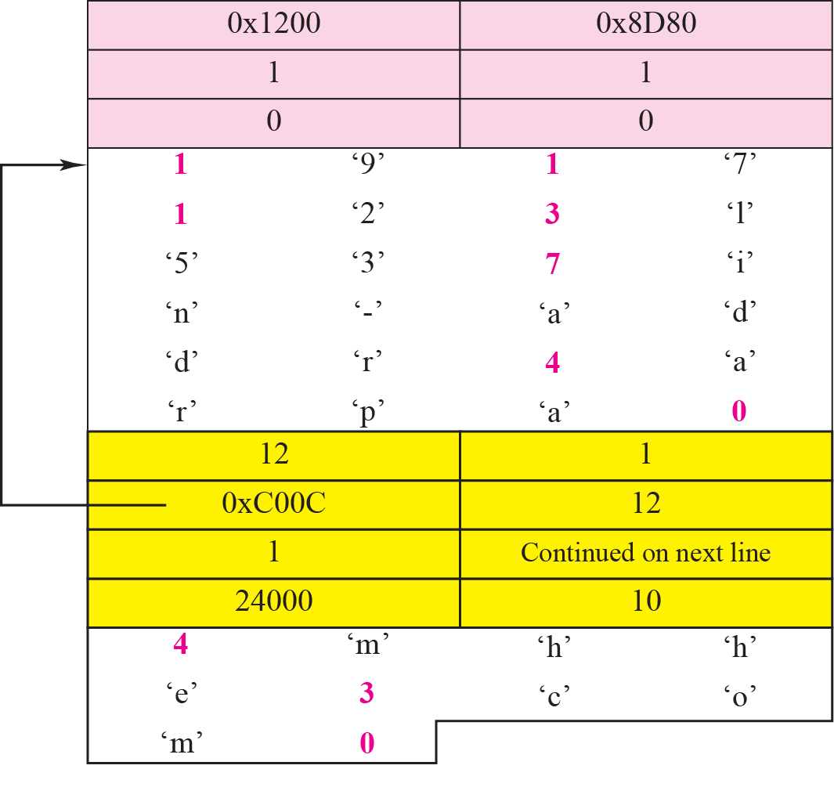
Figure 19.24 Example 19.2: Inverse response message

Slide 49
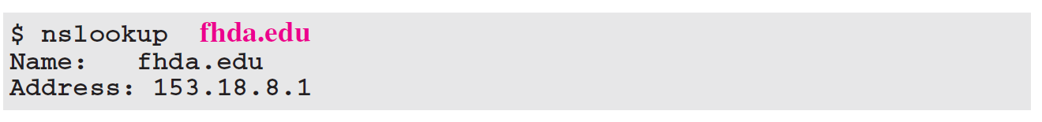
Example 19.3
In UNIX and Windows, the nslookup utility can be used to retrieve address/name mapping. The following shows how we can retrieve an address when the domain name is given.
The nslookup utility can also be used to retrieve the domain name when the address is given as shown below:

Slide 50
19-8 ENCAPSULATION
DNS can use either UDP or TCP. In both cases the well-known port used by the server is port 53. UDP is used when the size of the response message is less than 512 bytes because most UDP packages have a 512-byte packet size limit. If the size of the response message is more than 512 bytes, a TCP connection is used. In that case, one of two scenarios can occur:

Slide 51
19-9 REGISTRARS
How are new domains added to DNS? This is done through a registrar, a commercial entity accredited by ICANN. A registrar first verifies that the requested domain name is unique and then enters it into the DNS database. A fee is charged.

Slide 52
19-10 DDNS
When the DNS was designed, no one predicted that there would be so many address changes. In DNS, when there is a change, such as adding a new host, removing a host, or changing an IP address, the change must be made to the DNS master file. The DNS master file must be updated dynamically. The Dynamic Domain Name System (DDNS) therefore was devised to respond to this need.

Slide 53
19-11 SECURITY OF DNS
DNS is one of the most important systems in the Internet infrastructure; it provides crucial services to the Internet users. Applications such as Web access or e-mail are heavily dependent on the proper operation of DNS. DNS can be attacked in several
Ways.
To protect DNS, IETF has devised a technology named DNS Security (DNSSEC) that provides the message origin authentication and message integrity using a security service called digital signature (See Chapter 29).

